Slide 1
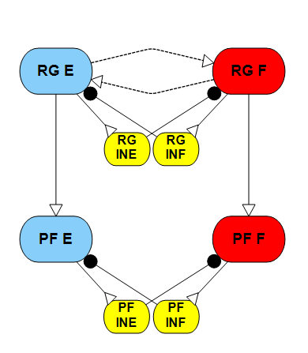
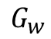


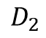

Aim 2:
Step 1
RG frequency control
Determine how Gw and drives/feedback influence the rhythm generation of the RG component.
Step 2
RG phase response curve
Investigate the influence of the Gw on the phase response to perturbations.
Step 3
Phase shift between the two layers of CPG
Quantify the phase shifts between the two layers of CPG caused by different stimulus/feedback.
$$D_{1}$$
$$G_{w}$$
$$G_{c}$$
$$G_{c}$$
$$D_{2}$$

Slide 2
Aim 2:
RG frequency control
2.09
4.372
6.0152
If we want a desired frequency of 1.1136 Hz, there are infinite solutions found by varying Gw and D1 Stimulus.
For example, possible solutions are [Gw D1] = [0 6.0152]; [0.1 4.372]; [0.3 2.09]; [0.59 0]. However, the performance for different conductances is not the same, as shown on the right.

Slide 3
Aim 2:
RG phase response curve
The perturbation response when an excitation stimulus of 5 nA injected into the extensor neuron during 0.3-0.5 of the normalized phase duration.
Top column:
Extensor neuron activities for unperturbed situation
Flexor neuron activities for unperturbed situation
Extensor neuron activities for perturbed situation
Flexor neuron activities for perturbed situation
Bottom column:
Neuron actives for the extensor neurons in the phase plane.
D = 6.0152; Gw= 0
D=0; Gw=0.59
The stimulus prolonged the active phase of extensor neuron for both cases. It shifts the phase for pure drive case by 10% and self-oscillation case by 7%.

Slide 4
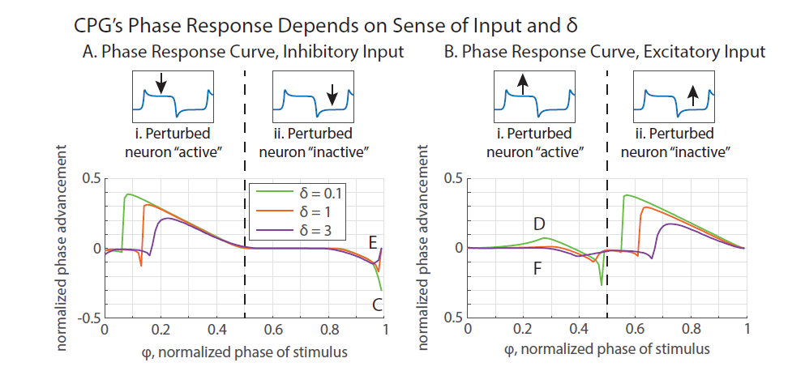
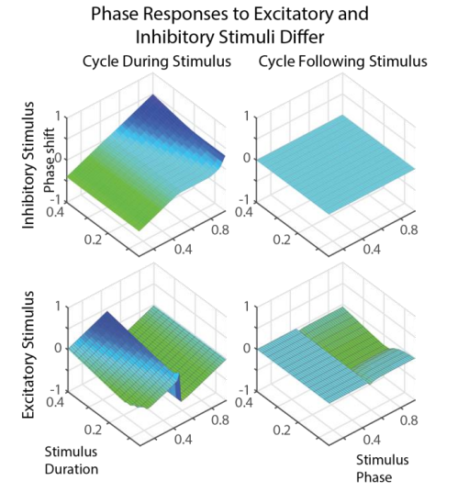
Aim 2:
RG phase response curve
(Szczecinski et al., 2017)
By setting Gw as zero, reproduce the results as shown in the figures using parameter values in reference.
Keep Gw as zero, produce the phase response curve using rat’s neural parameters.
Raise the Gw value so that it oscillates at the same frequency with no external inputs, producing the phase response curve.
(Szczecinski, Hunt, & Quinn, 2015)

Slide 5

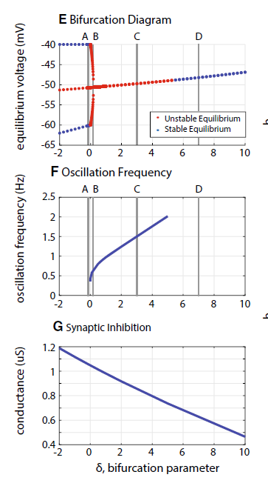
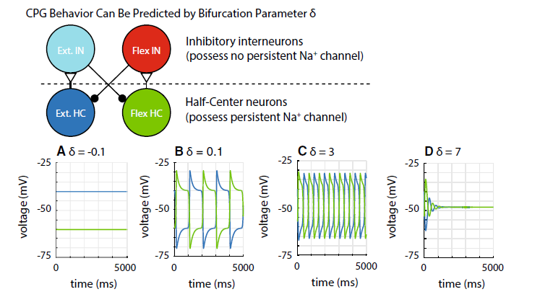
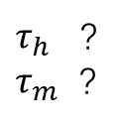
Interneurons: C_{m} = 5 nF, G_{m} = 1 uS, G_{Na} = 0 uS ,E_{r} = -60 mV.
HC Neurons: C_{m} = 5 nF, G_{m} = 1 uS, G_{Na} = 1 uS, E_{Na} = 50 mV, A_{h} = 0.5, S_{h} = -0.046, E_{h} = -60 mV,
A_{m} = 1, S_{m} = 0.046, E_{m} = - 40 mV.
$τ_{h}$ ?
$τ_{m}$ ?
HC→IN: g_{Syn} = 0.118 uS, E_{s} = 300 mV.
E_{lo} = -60 mV, E_{hi} = - 20 mV.
IN→HC: g_{Syn} = 1.041 uS, E_{s} = -100 mV.
E_{lo} = -60 mV, E_{hi} = - 20 mV.
g_{Syn} for inhibition and excitation is not same.

Slide 6
-5 nA
5 nA

Slide 7
Keep Gw as zero, produce the phase response curve using rat’s neural parameters.
No external drive, tuning the synaptic inhabitation
External drive = 6 nA, tuning the synaptic inhabitation
Conductance g_{Syn} = 2 uS, tuning the external drive

Slide 8
Keep Gw as zero, produce the phase response curve using rat’s neural parameters.

Slide 9
Keep Gw as zero, produce the phase response curve using rat’s neural parameters.
-5 nA
5 nA
No external drive, tuning the synaptic inhabitation
External drive = 6 nA, tuning the synaptic inhabitation
Conductance g_{Syn} = 2 uS, tuning the external drive

Slide 10
Raise the Gw value so that it oscillates at the same frequency with no external inputs, producing the phase response curve.

Slide 11
Raise the Gw value so that it oscillates at the same frequency with no external inputs, producing the phase response curve.

Slide 12
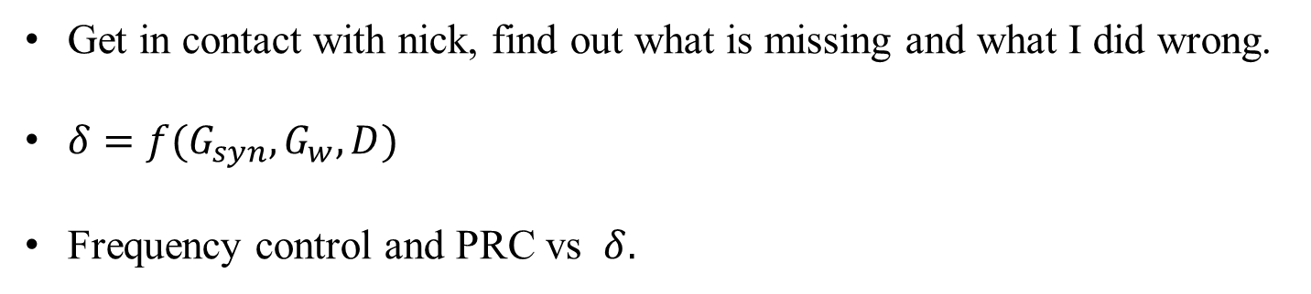
Next steps:
Get in contact with nick, find out what is missing and what I did wrong.
$δ=f(G_{syn},G_{w},D)$
Frequency control and PRC vs $δ.$

Slide 14
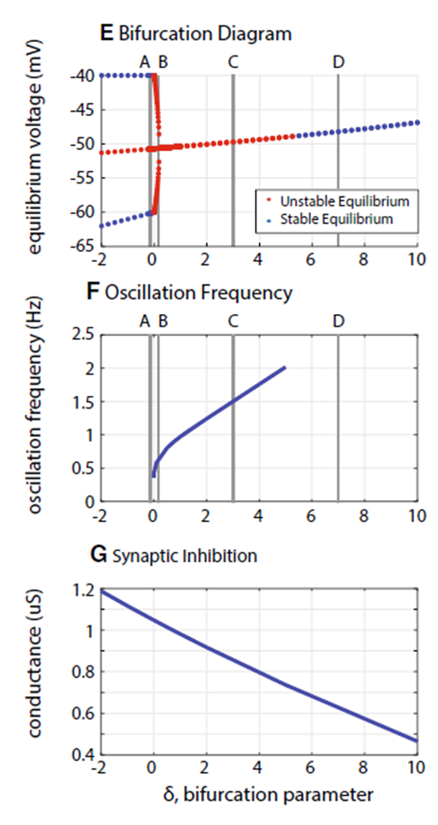

Slide 15
Keep Gw as zero, produce the phase response curve using rat’s neural parameters.
No external drive, tuning the synaptic inhabitation
External drive = 6 nA, tuning the synaptic inhabitation
Conductance g_{Syn} = 2 uS, tuning the external drive

Slide 17
5
1
0.5

Slide 18
D = 0
D = 6

Slide 19
D = 6; Gw = 0, tuning the G
G = 2; Gw = 0, tuning the D

Slide 20
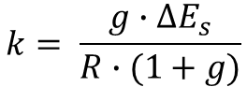
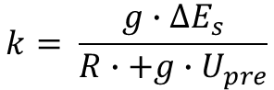
$$k= \frac{g∙∆E_{s}}{R∙(1+g)}$$
$$k= \frac{g∙∆E_{s}}{R∙+g∙U_{pre}}$$

Slide 21
No drive
With a D = 6 nA

